Slide 1
Credit Card
Weekly
Status Report

Slide 2
Content in this tutorial
1. Data Integration
3. KPI Identification
4. Dashboard Design
5. Performance Optimization
6. Data processing & DAX
7. Data from SQL
8. Export & share project

Slide 3
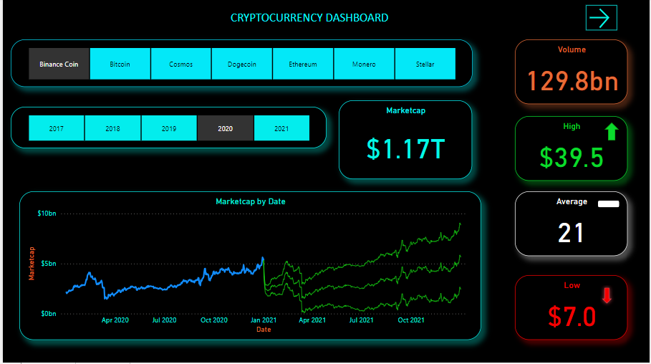
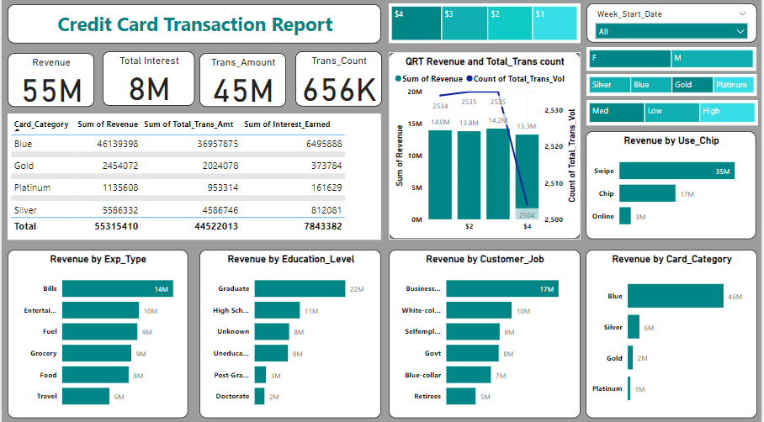
POWER BI PROJECTS
AMAN KUMAR

Slide 4
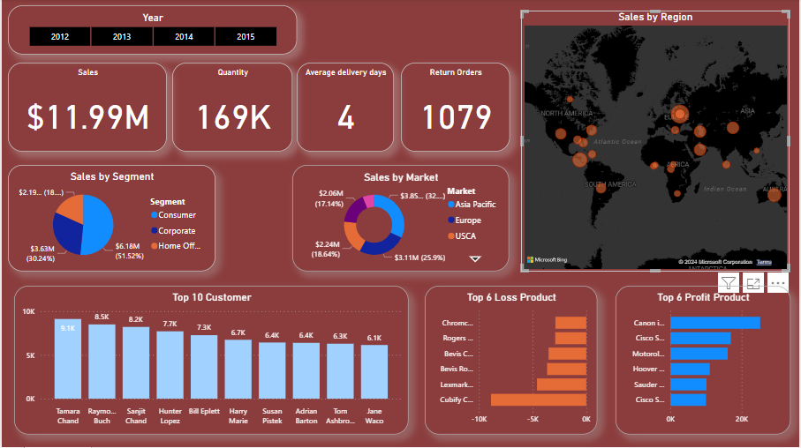
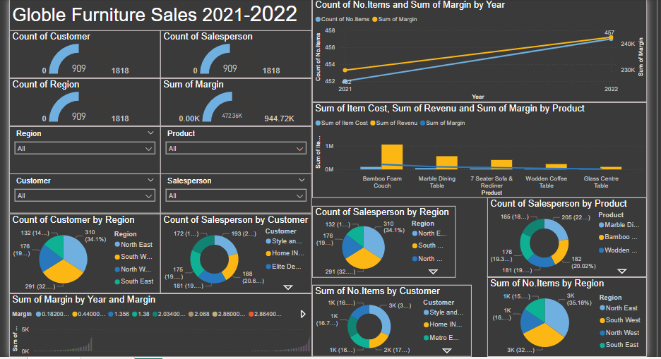
POWER BI PROJECTS
AMAN KUMAR

Slide 5
Project Objective
To develop a comprehensive and interactive Power BI dashboard that enables stakeholders to visualize and analyze key performance indicators (KPIs) and business metrics, facilitating data-driven decision-making and improving overall business efficiency.
AMAN KUMAR

Slide 6
Import data to SQL database
Prepare csv file
Create tables in SQL
Import csv file into SQL
AMAN KUMAR

Slide 7
DAX Queries
AgeGroup = SWITCH(
TRUE(),
'public cust_detail'[customer_age] < 30, "20-30",
'public cust_detail'[customer_age] >= 30 && 'public cust_detail'[customer_age] < 40, "30-40", 'public cust_detail'[customer_age] >= 40 && 'public cust_detail'[customer_age] < 50, "40-50", 'public cust_detail'[customer_age] >= 50 && 'public cust_detail'[customer_age] < 60, "50-60", 'public cust_detail'[customer_age] >= 60, "60+",
"unknown"
)
IncomeGroup = SWITCH( TRUE(),
'public cust_detail'[income] < 35000, "Low",
'public cust_detail'[income] >= 35000 && 'public cust_detail'[income] <70000, "Med", 'public cust_detail'[income] >= 70000, "High",
"unknown"
)
AMAN KUMAR

Slide 8
DAX Queries
week_num2 = WEEKNUM('public cc_detail'[week_start_date])
Revenue = 'public cc_detail'[annual_fees] + 'public cc_detail'[total_trans_amt] + 'public cc_detail'[interest_earned]
Current_week_Reveneue = CALCULATE( SUM('public cc_detail'[Revenue]), FILTER(
ALL('public cc_detail'),
'public cc_detail'[week_num2] = MAX('public cc_detail'[week_num2])))
Previous_week_Reveneue = CALCULATE( SUM('public cc_detail'[Revenue]), FILTER(
ALL('public cc_detail'),
'public cc_detail'[week_num2] = MAX('public cc_detail'[week_num2])-1))
AMAN KUMAR

Slide 9
Project Insights- Week 53 (31st Dec)
WoW change:
• Revenue increased by 28.8%,
• Total Transaction Amt & Count increased by xx% & xx%
• Customer count increased by xx%
Overview YTD:
• Overall revenue is 57M
• Total interest is 8M
• Total transaction amount is 46M
• Male customers are contributing more in revenue 31M, female 26M
• Blue & Silver credit card are contributing to 93% of overall transactions
• TX, NY & CA is contributing to 68%
• Overall Activation rate is 57.5%
• Overall Delinquent rate is 6.06%
AMAN KUMAR

Slide 10
Add to resume
Credit card financial dashboard using Power BI:
• Developed an interactive dashboard using transaction and customer data from a SQL database, to provide real-time insights.
• Streamlined data processing & analysis to monitor key performance metrics and trends.
• Shared actionable insights with stakeholders based on dashboard findings to support decision-making processes
AMAN KUMAR

Slide 11
Download Data
GitHub:
https://github.com/AmanKumar321-ai/Credit_Card_Financial_Dashboard
AMAN KUMAR

Slide 12
THANK YOU
AMAN KUMAR

